Slide 2
225,822

Slide 4
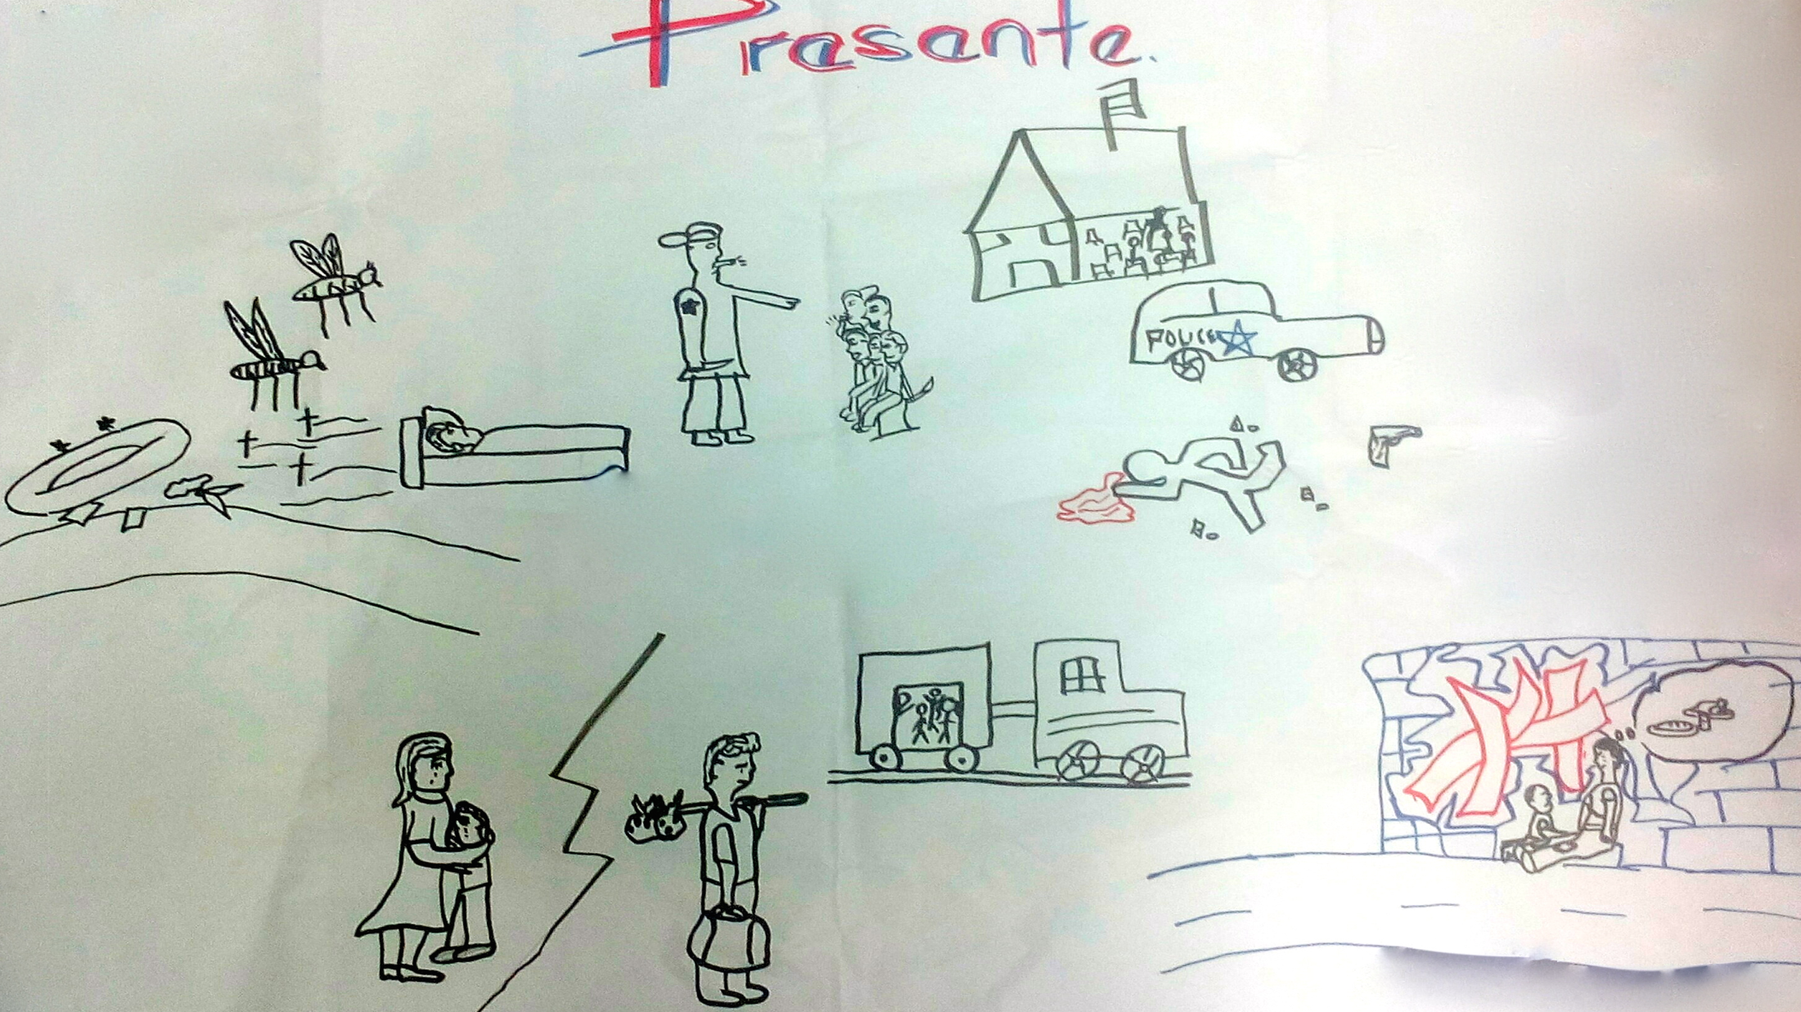
22 %
11
214

Slide 6
Profile to stay or leave
TO
STAY
TO
LEAVE
Homes without networks in other municipalities or outside the country.
Low Academic Performance.
Male.
Rural Origins.
Age.
Largest Families.
Urban settings.
Push factors
Motivations
Same of 4 years ago
Family violence, lack of adequate care for protection of children.
Violence in schools and community, lack of sense of security.
Lack of decent and safe economic opportunities for youth.
Lack of access to relevant educational opportunities leading to employment.
Substantial family network in the country and in the destination.
Insecurity due to violence.
Look for better economic opportunities.

Slide 8
