Slide 1

WHY HAS NOBODY COME BACK HERE?
MONITORING PHYSICAL AND SOCIAL CONDITIONS IN PLACES OF ORIGIN TO UNDERSTAND IDP RETURN PATTERNS
ROGER GUIU
GENEVA, 01 OCTOBER 2019
#ROADTO2030

Slide 2
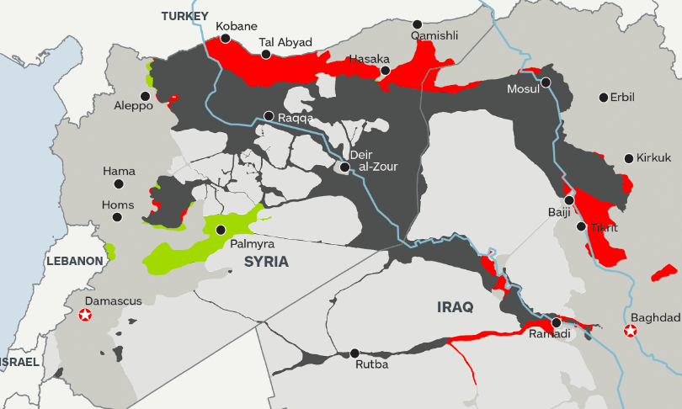
SETTING THE SCENE
Working to support the response to the displacement crisis triggered during the ISIS conflict in Iraq (2014-2017).
Infographic source: IHS.

Slide 3
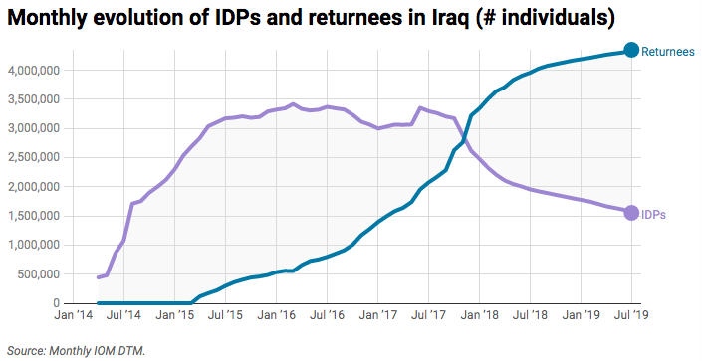
SETTING THE SCENE
RETURNEES
4.3 MILLION
PEOPLE
ISIS ADVANCE THROUGH CENTRAL IRAQ
IDPs
1.6 MILLION
PEOPLE
OFFICIAL END OF CONFLICT

Slide 4
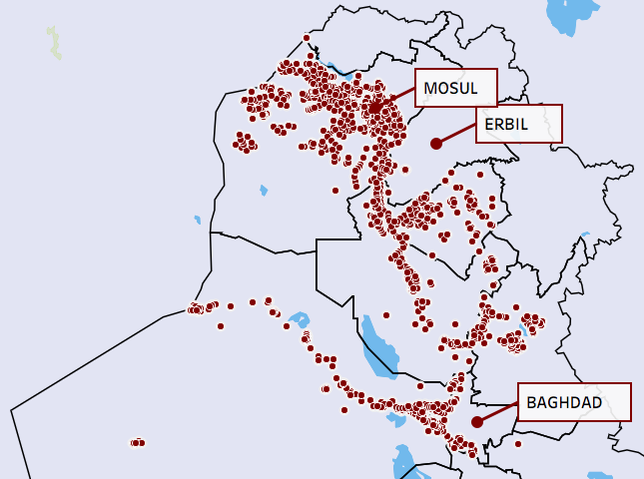
SETTING THE SCENE
Where are IDPs returning to from displacement?

Slide 5
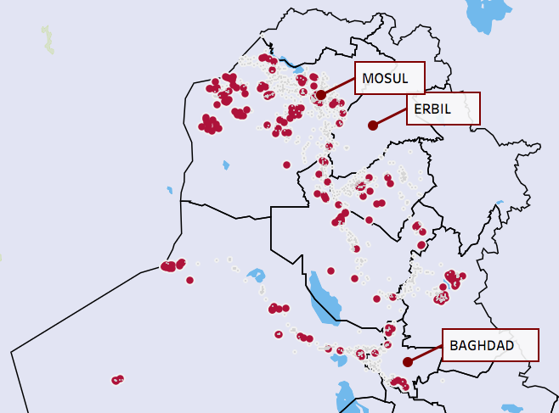

SETTING THE SCENE
Where are IDPs NOT returning to from displacement?
The areas in red indicate locations with very limited returns.

Slide 6
CONSTRUCTING AN INDEX TO MONITOR SEVERITY IN RETURNS
This situation raised some questions worth exploring:
  Why are IDPs not returning to these places?
  What are the physical and social conditions that determine these differences?
  How are conditions changing across time and with programming?
Social Inquiry, IOM DTM Iraq, and the Returns Working Group aimed to build a tool to understand returns movements and evaluate the quality / sustainability of returns… [RETURN INDEX].

Slide 7
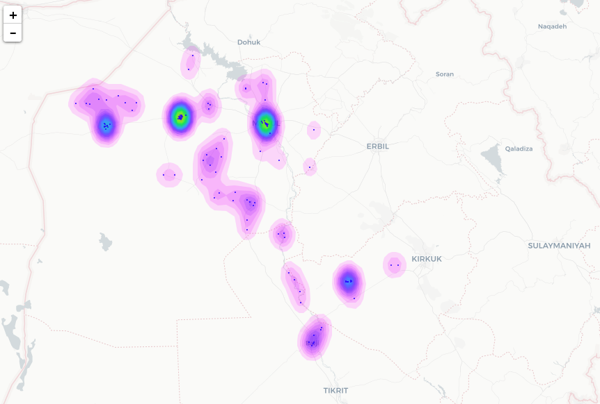
CONSTRUCTING AN INDEX TO MONITOR SEVERITY IN RETURNS
LAYER 1 (PROXY)
Areas with low return rates
Areas with secondary displacement
GEOGRAPHICAL DATA AT LOCATION LEVEL
!!

Slide 8
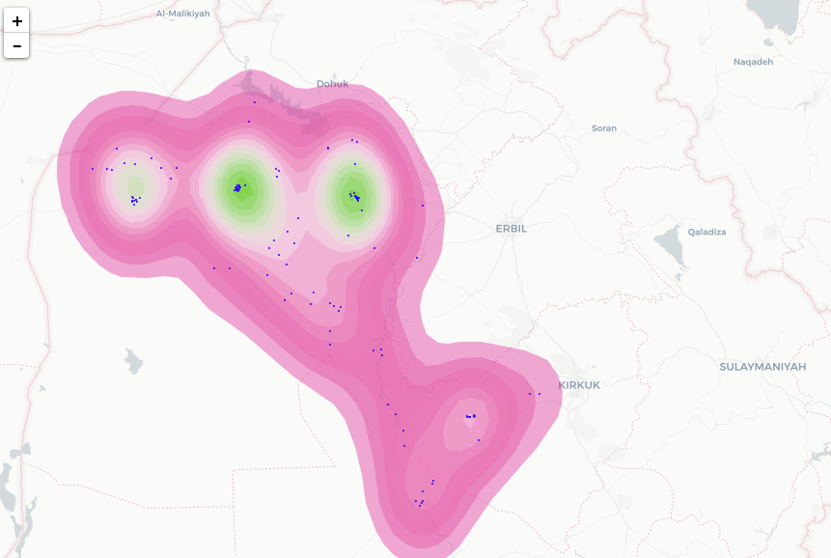
CONSTRUCTING AN INDEX TO MONITOR SEVERITY IN RETURNS
Main assumption to base the model:
Locations that do not have all returns are likely to present lack of services, livelihoods, social cohesion or safety → SEVERITY OF CONDITIONS IN RETURN.
LAYER 2
Indicators on physical conditions
Indicators on social conditions
LAYER 1 (PROXY)
Areas with low return rates
Areas with secondary displacement
GEOGRAPHICAL DATA AT LOCATION LEVEL
!!

Slide 9
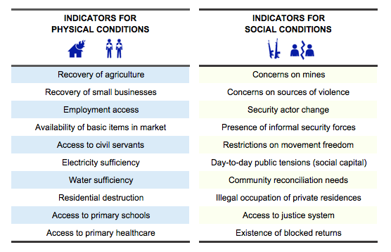
CONSTRUCTING AN INDEX TO MONITOR SEVERITY IN RETURNS
First step: what indicators can help us explain severity in returns?

Slide 10
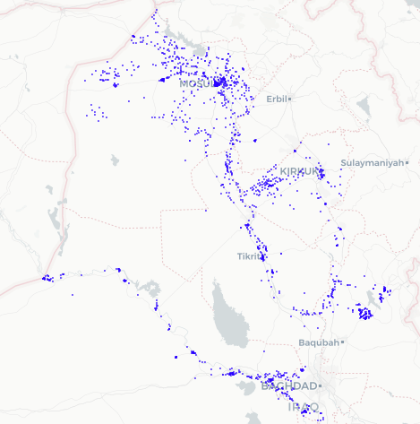
CONSTRUCTING AN INDEX TO MONITOR SEVERITY IN RETURNS
Data collected in +1,500 locations with returns.
HAY YARMOK (SINJAR CENTRE):
Less than half the population reported returned.
Physical conditions:
>50% of houses are still destroyed severely damaged, and no reconstruction.
Very limited access to employment.
Near no small business has been restored.
Primary school is closed or not functioning, but children can attend school nearby.
PHC is closed or not functioning, but residents able to receive medical care nearby.
There is a scarcity of items in the local markets and small shops.
10 hours/day of public electricity.
No public water supply.
Some of the public sector employees are reincorporated in their jobs.
There is no farming at this location (N/A)
Social conditions:
Many houses are occupied without permission.
Streets are busy with residents carrying out daily activities but it feels tense.
There are 3 or less armed groups in control of the location.
There are no restrictions of movement.
There is somewhat concern for revenge, ISIL attacks, and ethno-religious tensions.
Different ethnic / religious / tribal groups rarely or ever participate in joint initiatives.
There was no security change reported from last month.
There is a reported need for community reconciliation and it is not happening.

Slide 11
CONSTRUCTING AN INDEX TO MONITOR SEVERITY IN RETURNS
Data collected in +1,500 locations with returns.
From too little information to probably too much?

Slide 12
CONSTRUCTING AN INDEX TO MONITOR SEVERITY IN RETURNS
Need to generate an index that combines all the data in one measurement:
We developed a multivariate model to measure how much each indicator explains lack of returns (as a proxy for severity or “sustainability” of returns).
Responses to each indicator are combined to generate a score for each location → maximum possible score is 100 (i.e. no basic condition met for any indicator).
Each indicator contributes differently to the score, based on its impact on returns (i.e. what the model says).
The higher the score, the more dire situation for returnees → it may prevent returns, or subject people to protracted poor conditions.
LEVEL OF RETURNS
SEVERITY OF
PYSICAL AND SOCIAL CONDITIONS

Slide 13
LESSONS LEARNED FROM IMPLEMENTATION
From the application of the Return Index in Iraq, SIX main lessons learned.

Slide 14
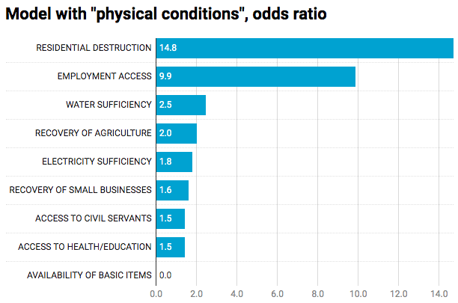
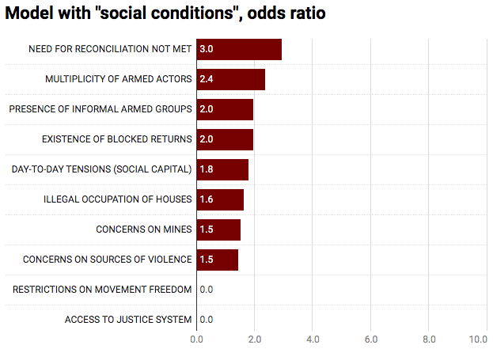
LESSONS LEARNED FROM IMPLEMENTATION
#1
Some indicators are more relevant than others in explaining returns.
Interpretation: Locations with residential destruction are 15 times less likely to experience returns than locations with no destruction.

Slide 15
LESSONS LEARNED FROM IMPLEMENTATION
#1
Some indicators are more relevant than others in explaining returns.
Indicators that address the root causes of the conflict are ALSO some of the most important.

Slide 16
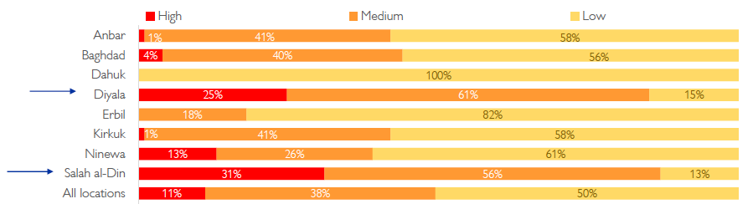
LESSONS LEARNED FROM IMPLEMENTATION
#2
The importance of prioritizing the most severe areas with an evidence base.
Distribution of returning families per governorate based on severity categories:
In some governorates, 1 of every 4 returnees are going back to locations that are categorized as high severity.
HIGH SEVERITY
MEDIUM SEVERITY
LOW SEVERITY

Slide 17
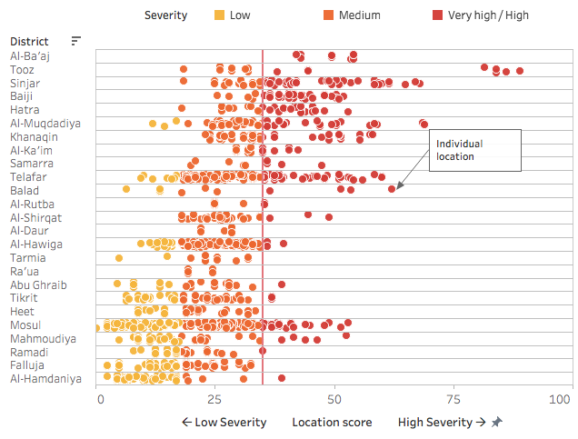
LESSONS LEARNED FROM IMPLEMENTATION
#2
Using it to prioritize the most severe areas using an evidence base.
Other ways to monitor severity of conditions, more individualized.
Based on this, we identified 20 hotspots that are monitored in more detail.
Hotspot? Cluster of locations with high severity.
INDIVIDUAL LOCATION

Slide 18
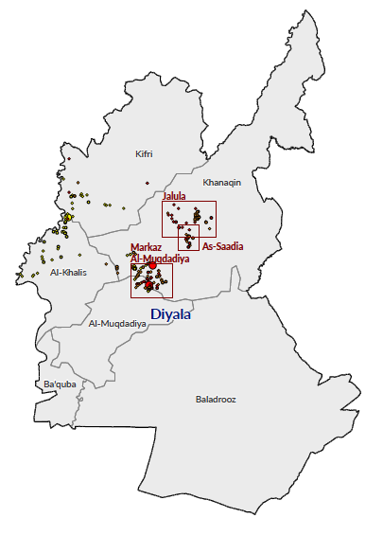


LESSONS LEARNED FROM IMPLEMENTATION
Severity hotspots in Diyala Governorate:
#3
It still remains important to look behind the index score.
Jalawla subdistrict
Drivers of severity:
Beyond identifying the hotspots we need to know what specifically drives severity in each of them → many of the drivers are localized.
This information is necessary to better focus programmatic intervention → we need to act, but on what?
Saadiya subdistrict
Drivers of severity:
Muqdadiya subdistrict
Drivers of severity:

Slide 19
LESSONS LEARNED FROM IMPLEMENTATION
#4
Comparing severity conditions and actor coverage helps identify the gaps in the interventions.

Slide 20
LESSONS LEARNED FROM IMPLEMENTATION
DATA FROM OCHA IRAQ
#4
Comparing severity conditions and stakeholder coverage helps identify the gaps in the interventions.
There are multiple ways to measure “coverage”, such as number of partners present, number of beneficiaries, number of programs and allocated funds…
...but each has pros and cons, and not all data is available and transparent. Any measurement is also likely to miss the quality of implementation.

Slide 21
LESSONS LEARNED FROM IMPLEMENTATION
#5
Work in progress:
Using a temporal comparison round after round to identify trends.
In addition to geographical comparison, the data should aim to allow for a temporal comparison of scores.
Comparing scores between rounds of data collection → to see where conditions have improved or deteriorated.
Lay the basis for further investigation into changes in context, including those related to policy and program implementation (or gaps).

Slide 22
LESSONS LEARNED FROM IMPLEMENTATION
#6
How sustainable is the Return Index?
Need to connect it better.
There are two questions emerging from this presentation:
How to better connect with global frameworks and conversations such as Durable Solutions and SDG?
How to make it applicable to other displacement contexts without losing comparability?

Slide 23
THANK YOU
www.social-inquiry.org
roger@social-inquiry.org

